Slide 1
CyPERS
Prepared By: Ajay Agrawal
Prepared On: 10th May 2010

Slide 2
Audience
Project Sponsors
Senior Management
Project Team Members

Slide 3
Project Objective
To Develop a web based solution to manage the Patient information electronically
Registered hospital should be able to manage their patient information locally.
Central Repository for all registered Hospital data.
Data transmission between hospital should be based on HL7 specification.

Slide 4
Project Planning Methodology
Agile Methodology
Phase Wise Development

Slide 5
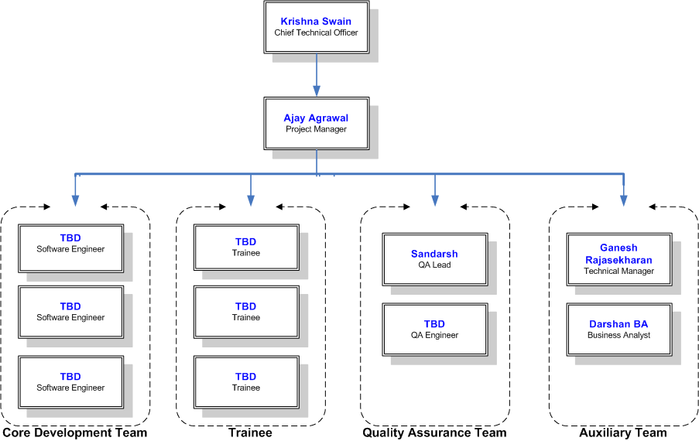
Project Organization Chart

Slide 6
Roles & Responsibility
Project Manager
The role of a Project Manager in team is to lead the project team with structured project management methodologies and take ownership for completion of assigned projects within budgetary and scheduling guidelines.
Technical Architect
The role of Java Technical Architect is to lead the process of converting business requirements into an architecture and design which will become a blueprint for the solution being created.
Business Analyst
Translate business requirements to functional specifications and assist the Business Users in making scope decisions by providing information on trade-off between cost, time, complexity and usability.
Quality Team
Ensure that testing activities will allow applications to meet business requirements and systems goals, fulfill end-user requirements, and identify and resolve systems issues.
Software Engineer
The Java Programmer is the part of the core development team and be responsible for the development of the Product / Applications CyPERS.

Slide 7
Quality Objective
As this project is for the health care provider so the project quality should be thorough tested.

Slide 8
Configuration Management
Document Management
All the project related document should be manage on the Microsoft SharePoint Server. SharePoint is a Microsoft product that manages the tasks and information of an organization with respect to their hierarchy levels.
http://192.168.1.11/pmo
Source Code
All the Project source code will be manage in the CVS tool. The Concurrent Versions System (CVS), also known as the Concurrent Versioning System, is a free software revision control system in the field of software development.
:pserver;username=<username>;password=<password>;hostname=ignis-sav;port=2401:/cvsprojects/cypers

Slide 9
Tools & Technique
Bug Tracking Tool
Team has to use the Bugzilla tool for any kind of product bug management.
Use Case Development
Business Analyst will use the StarUML tool for UML designing.
Automatic Build
Team will use the Cruise Control tool for Automatic build.

Slide 10
Server Information

Slide 11
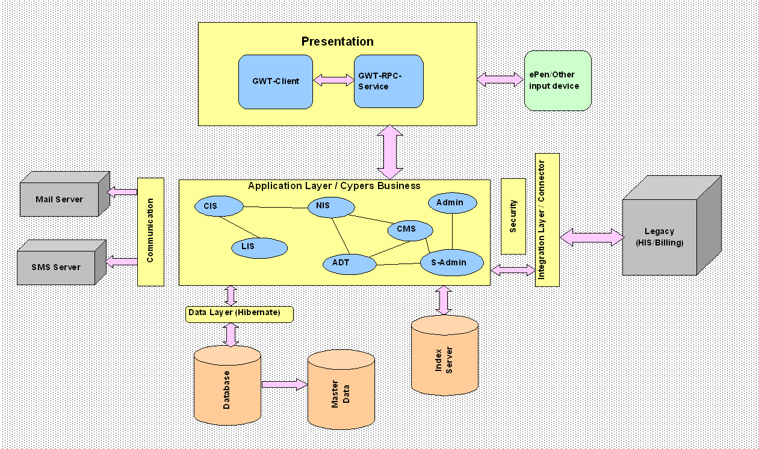
CyPERS Architecture

Slide 12
Thank You

